Slide 1
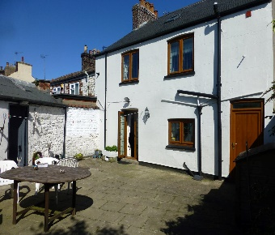
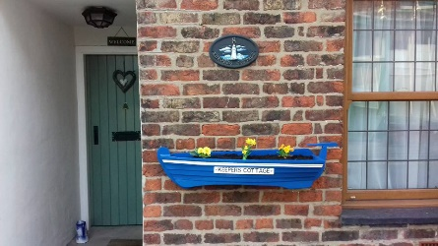
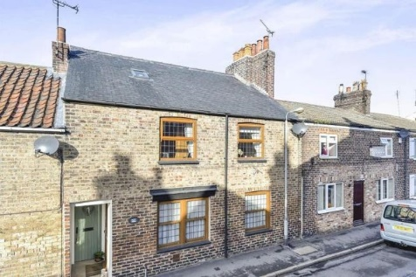
KEEPERS COTTAGE
HIGH ST
FLAMBOROUGH
Directions
From Northampton -M1 to Junction 32, M18 to Junction 7, M62 to junction 37, A614 to Howden, A614 to Bridlington, B1255 to Flamborough.
We usually get off the motorway and stop at Howden – lovely little place with a fantastic place to eat called “The Kitchen” (past small co-op and near post office) for delicious food.
Arrivals – after 1pm
Departures – by 11am
EMERGENCY NUMBERS
JENNY 07812 704873 / DAVE 07497 183014
John– friend who live in Flamborough – 07765 410067
Keepers Cottage is a three doubled bedroomed terraced cottage right in the centre of Flamborough village. Built over 100 years ago it is believed to be the former village butcher’s shop. Keepers Cottage has retained many of its original features, and this combined with modern additions such as ensuite and roll top bath to master bathroom make this quirky and cosy cottage an ideal base for exploring East / North Yorkshire.

Slide 2
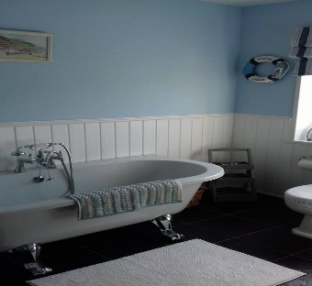
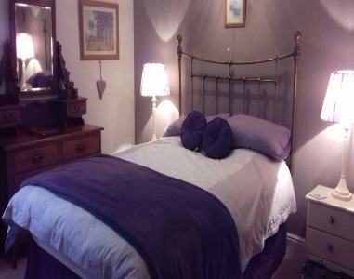
KEEPERS COTTAGE
The cottage is over two floors, with on street parking outside in the High Street. The three bedrooms are double beds, the kitchen diner has a range cooker, fridge, freezer and dishwasher. The patio garden is ideal for sunbathing and BBQ’s.
The cottage is non-smoking, duvets and pillows are provided however guests are to take own double fitted sheets, pillowcases and duvet cover. Please take own towels and tea towels.
Flamborough itself is ideal for those who like walking, cycling, birdwatching and nature. The rugged Heritage Coast of Flamborough is one of the Yorkshire coast’s most dramatic locations. A short walk away will take you to the beaches of North and South Landing which offer some rock-pooling and a chance to spot seals, porpoises and sometimes dolphins. With its two Lighthouses, the original being built over 300 years ago from chalk stone. There is a plentiful selection of friendly pubs a couple of fish and chip shops, a pizza takeaway, cake shop, a well-stocked Co-Op supermarket and cafes making it a perfect location for taking it easy any time of year and enjoying the beautiful scenery Yorkshire has to offer.
Available all year round for weeks and short breaks (3-night minimum booking).
Please note there is wi-fi in the cottage. Details can be found on the router.
We ask that all guests please leave the cottage clean and tidy for the next guests to enjoy.
Jenny & Dave
OTHER INFORMATION
York – Use the park & ride scheme.
Harrogate – Betty’s Tea Room, Designer shops.
Car Boots / Auctions
There are quite a few regular car boots in the area :-
Strawberry fields in Bridlington - (Tues, Thurs & Bank Holiday Mondays) Open Tuesdays from 5th June to end of September. Yorkshire's Biggest & Best Car Boot & Market, Bridlington YO15 3NG
Arrive from 6am - closing time 2pm
Skirlington Car Boot Sale Open 6am - 2pm every Sunday . (Closed January Only)
Lebbertson Car Boot - Every Sunday and Bank Holiday Monday. Also every Wednesday during July and August. Sellers from 6am. Buyers from 6.30am.
Spencer Auctions – Bridlington – viewing Wednesday, auction Thursday.

Slide 3
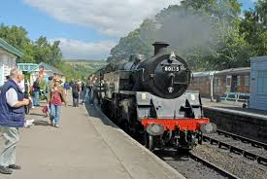
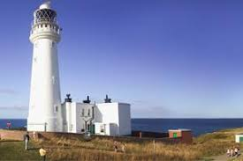
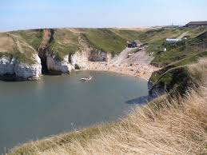
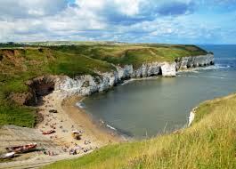
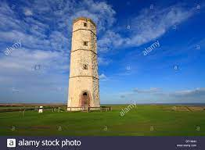
The North Yorkshire Moors Railway
If you like steam trains, there is one operating on The North Yorkshire Moors Railway line it goes from Pickering (about an hour away) all the way up to Whitby and back. Booking in advance recommended. It goes through a few pretty stations, including where they filmed Heatbeat.
Local Area Information
Flamborough
A perfect location for a holiday for everyone with it's many places of interest.
North Landing - a cove surrounded by white chalk cliffs with caves to explore, rock pools to investigate, Puffins, Razor Bills and Seals can often be seen here. By the car park you'll find the Caravel Bar with it's lovely views of the sea and a Cafe.
South Landing - has a white pebbled beach with the inshore Lifeboat Station, a RNLI Shop and the Living Sea Centre.
Lighthouse - right at the very tip of Flamborough Head stands the Lighthouse, a gift shop, the Headlands Restaurant and Bar.
Old Lighthouse - built over 300 years ago is the earliest known lighthouse still in existence in the UK.
Golf Course - this is also on Flamborough Headland and open to visitors.
Pubs - The Seabirds, Dog & Duck, Rose & Crown, The Ship, The Viking, The North Star, The Caravel Bar & The Headlands Bar.
Thornwick Bay & Caves.
It is just a great place for - walking, scenery, wildlife, sea life & birdwatching and exploring.
One of the most picturesque of the villages in the National Park lies in a natural hollow or hole, hence its name. On either side are the limestone headlands of the Tabular Hills, while to the north the land rises steadily to heather-clad Spaunton Moor.
A clear moorland stream, Hutton Beck, splashes and winds its way through the pillowy mounds that form the village green, traditionally cropped by the local sheep. Come to walk or cycle, or picnic on the green, and save time to visit the open-air Ryedale Folk Museum, right in the centre of the village.
Ryedale Folk Museum can easily take up half a day of your time, housing over 20 reconstructed buildings, including Iron Age roundhouse, Tudor mansion, vintage photographer's studio, craft workshops and farm buildings.

Slide 4
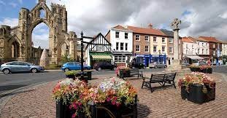
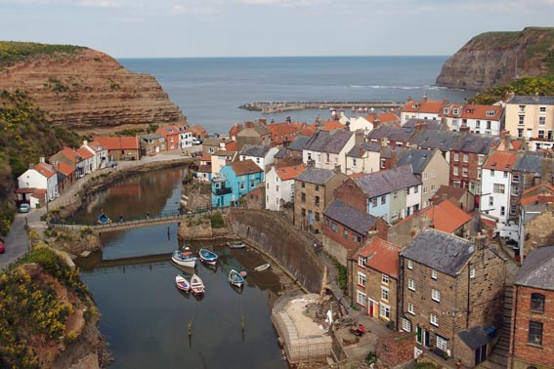
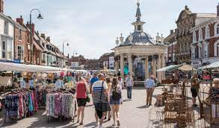
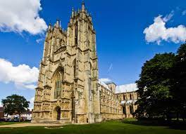
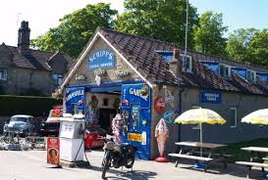
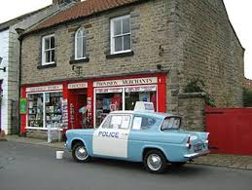
Howden
Staithes
Beverley
With its higgledy-piggledy cottages and winding streets, Staithes has the air of a place lost in time. Once one of the largest fishing ports on the North East coast, this coastal hamlet is now a well-loved base for exploring Yorkshire's cliff top paths and discovering the delights of rock pooling and fossil hunting on the small sandy beach.
If travelling up on a Saturday – and you like shopping! can recommend setting the sat nav for Beverley and visiting the farmers market and lovely shops before heading onto Flamborough. On Beverley market you will find local Yorkshire produce as well as plenty of deli type shops – and Ye Olde Pork Shop at the top end of the market opposite Marks & Spencer’s. There is 3 hours free parking in Tesco’s or a pay and display near by for longer stays. Public toilets are in Tesco’s or by the bus station
Goathland
Is where they filmed Heartbeat, tea shops, pub, sheep and steam railway – pretty.
Farmers market on a Saturday – Lots of Independent shops as well as lovely places to eat. Try Vanessa’s Deli, or a visit to Beverley Minster, or Beverley Races.

Slide 5
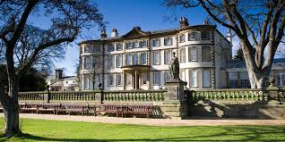
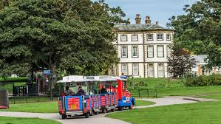
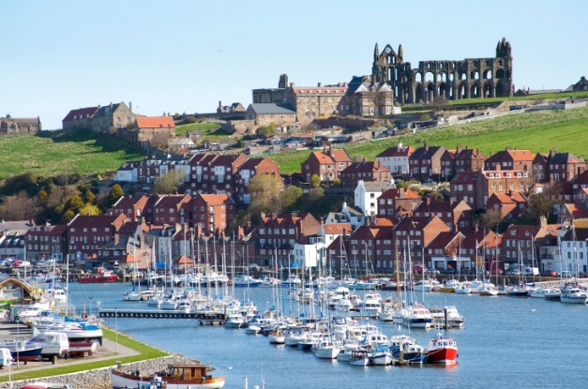
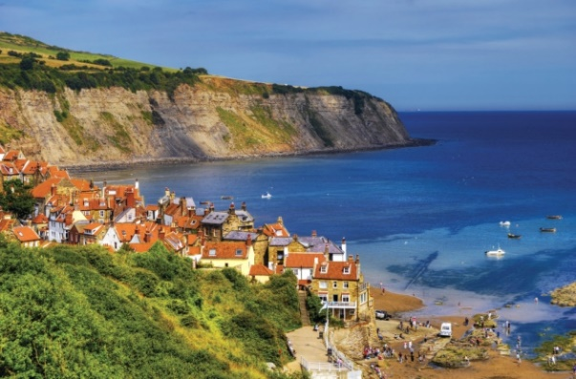
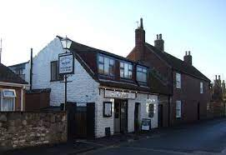
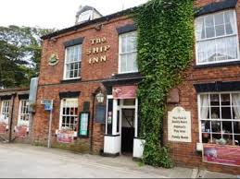
Pickering
Worth a visit :- The North Yorkshire Moors Railway
Get away from the hustle and bustle of city life and climb aboard a steam train like Harry Potter for the ultimate trip through Heartbeat Country in cosy compartments on the world’s most popular heritage railway. Pickering Castle - A splendid castle with a rich history, Pickering Castle served as a Northern base for a succession of medieval kings. Originally built after the Norman Conquest, the motte and bailey fortification was extensively developed throughout the 12th, 13th and 14th centuries. St Peter’s & St Paul’s Church Home to some stunning and world famous 15th century wall paintings, St Peter’s and St Pauls is a beautiful 12th century parish church in the centre of the town.
Driffield – small market town.
Sewerby Halls & Gardens
Uniquely situated in a dramatic clifftop position with spectacular views over Bridlington and set in 50 acres of early 19th Century parkland, Sewerby Hall and Gardens offers something for everyone, from the magnificent gardens and zoo to the deep rooted heritage of the house – there is a lovely bistro in Sewerby called “The Old Forge” which does lovely lunches and evening meals. There is also a pub called The Ship in Sewerby that has live entertainment in the summer in the garden.
You can park free in the grounds of Sewerby Hall and walk along the cliff tops or on the beach into Bridlington, if you get tired you can catch the little land train that runs from Bridlington to Sewerby.
Bridlington
This popular seaside resort is just a few miles south of Flamborough and has Blue Flag Award Winning beaches, an historic harbour, a Priory with the Bayle Museum in the Old Town. There's a Fun Fair on the promenade, speed boat rides and pleasure cruises from the harbour and plenty for the whole family to do. Bridlington Old Town has a few art galleries, tea shops and antique shops.
Whitby
Get there early for parking or use the Park & Ride scheme
Robin Hoods Bay

Slide 6
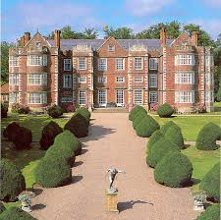
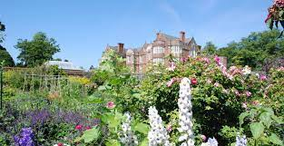
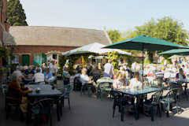
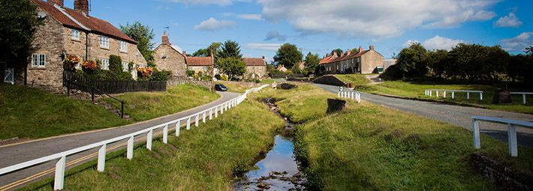
Burton Agnes – Hall & Gardens
Hutton Le Hole
One of the most picturesque of the villages in the National Park lies in a natural hollow or hole, hence its name. On either side are the limestone headlands of the Tabular Hills, while to the north the land rises steadily to heather-clad Spaunton Moor.
A clear moorland stream, Hutton Beck, splashes and winds its way through the pillowy mounds that form the village green, traditionally cropped by the local sheep. Come to walk or cycle, or picnic on the green, and save time to visit the open-air Ryedale Folk Museum, right in the centre of the village.
Ryedale Folk Museum can easily take up half a day of your time, housing over 20 reconstructed buildings, including Iron Age roundhouse, Tudor mansion, vintage photographer's studio, craft workshops and farm buildings.
Reighton Sands Beach
Worth a visit, if you like plants there is a very old-fashioned garden nursery called Reighton Sands Nursery that has field upon field of every plant known to man.
Filey
To the north of Flamborough about a 5-mile drive away. Filey is a perfect place for those who enjoy a gentler pace of life. With it's beautiful large bay Filey beach is one of the best in the country for families. It is the perfect place to take a walk, fly a kite, build a sandcastle, doze in a deckchair, or maybe do a spot of bird watching. Filey Brigg, a peninsula at the northern end of the town. In early spring you may find a seal on the beach, and in summer porpoise sightings are regular. Visit Coble Landing, a slipway with boats (cobles) and cafes.
Scarborough
Is the original seaside resort with stunning scenery, glorious beaches and loads to see and do. Explore Scarborough's history at Scarborough Castle and the Rotunda Museum of geology. On the seafront you will find the traditional amusement arcades, ice cream parlours, shellfish stalls and beach huts. Try boating in Peasholm Park; take a ride on the miniature railway or visit the Sea Life Sanctuary. During the summer at the Open-Air Theatre shows and singers perform. Scarborough is approx 10 miles from Flamborough.

Slide 7
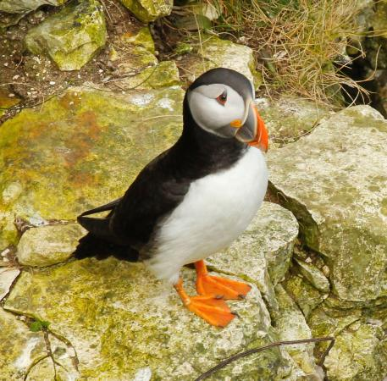
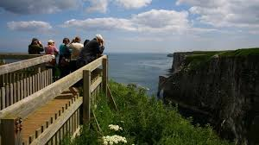
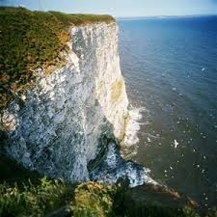
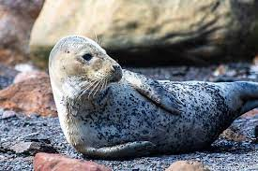
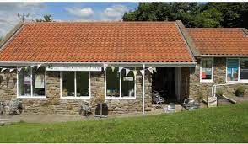
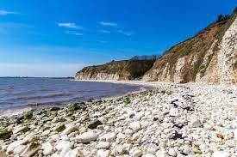
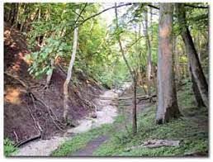
RSPB Bempton
Flamborough is just a stone’s throw away from one of the UK’s most famous RSPB reserves at Bempton, which boasts the largest nesting colony of gannets, puffins, razorbills, guillemots and other seabirds. There is a pub in Bempton called The White Horse that does meals and snacks.
Ravenscar
Situated at the southern end of Robin Hood's Bay, Ravenscar Visitor Centre is a welcoming gateway to the Yorkshire Coast. Here you'll find information about the local area, walking and cycling routes, events and self-led activities such as geocaching and wildlife watching. The rocky beach at the foot of the cliffs below Ravenscar is home to a growing colony of both common grey seals. According to North York Moors National Park, you have a great chance of seeing common seal pups- beware it’s a long climb down to the beach so wear good walking shoes. Plenty of public parking can be found on the road close by if early enough . The Cleveland Way National Trail and Cinder Track cycle route along the old Scarborough to Whitby railway line bring hikers and bikers right to the door. With picnic tables outside, it’s the perfect spot to rest and refuel with a hot or cold drink and a snack from our range of refreshments.
Danes Dyke
Is a Nature Reserve which runs the full width of Flamborough Headland, it is believed it was originally built in the Bronze Age as a defence for the land to the east of it. It has circular woodland walks and a path to the sea, a cafe and a pay and display car park.

Slide 8
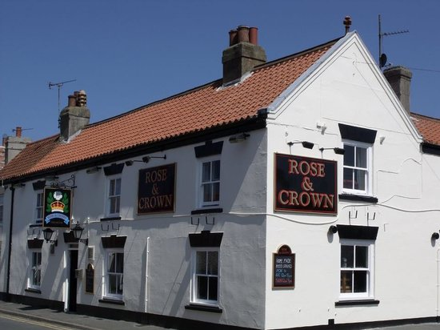
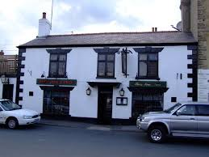
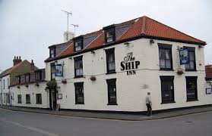
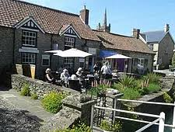
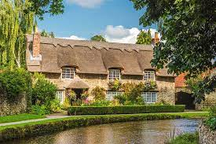

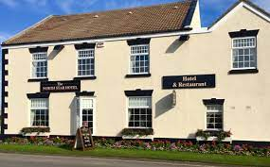
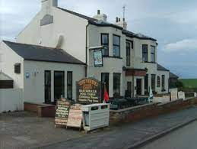
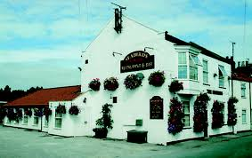
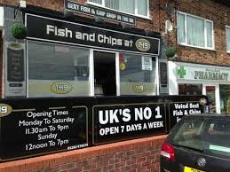
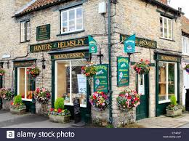
Dining & Pubs in Flamborough.
Most if not all the pubs in Flamborough do food (beware the portions are generally very big) and recommend booking in advance.
The Rose & Crown, Royal Dog & Duck, The Ship, & Seabirds are all within close walking distance of the cottage. The Viking & North Star are probably best by car – unless you like a 15 min walk before you eat.
FURTHER AFIELD
Thornton Le Dale
Pretty little village with a few shops, café’s. Go to a tea shop called Lavenders for fantastic scones cream and jam. Find the thatched cottage by the bridge, it is supposed to be Britain’s most photographed cottage. If you are into classic cars walk up to the auction garage where they film the classic car series “Bangers & Cash”.
Helmsley
Is a chocolate box village with some lovely little shops. Helmsley is the only market town in the North York Moors National Park and is the perfect base for enjoying the wider area. But there is plenty to do right here in the town, from fascinating attractions including the National Centre for Birds of Prey, Helmsley Castle. Helmsley Arts Centre and the Walled Gardens, to award-winning eateries and the town’s very own Brewery. Enjoy shopping in interesting and unique stores, galleries and boutiques – the town is even home to the winner of Britain’s Best Small Shop 2015.
Seabirds Restaurant is our favourite – however does get booked up quickly – they do a superb Sunday Lunch too.
The best fish & chip shop is on the way into Bridlington called 149 the address is 149 Marton Rd, Bridlington YO16 7DJ.

